Slide 1
Communication and interviewing skills
Module A3
Updated July 2016

Slide 2
Goals
Describe and show proficiency in effective communication with adolescents
Skillfully use the interview to build partnerships with the adolescent patient and his/her parents
Demonstrate proficiency in building a multidisciplinary network and in managing effective communication within the network

Slide 3
I. Describe and show proficiency in effective communication with adolescents

Slide 4
Impact of communication in healthcare
“Extensive research has shown that no matter how knowledgeable a clinician might be, if he or she is not able to open good communication with the patient and his/her family, he or she may be of no help.”
Institute for healthcare communication

Slide 5
Communication is not “just beeing nice” but produces more effective consultation for both patient and health professionals
Effective communication significantly improves
Accuracy, efficiency and supportiveness
Health outcomes for patients
Satisfaction for both patient and health professionals
Therapeutic relationship
Communication bridges the gap between evidence-based medicine and working with individual patients
Silvermann, Kurz,Draper

Slide 6
Communication is a core clinical skill, an essential element of clinical practice
Communication skills need to be taught and learned
content skills WHAT YOU SAY
process skills HOW YOU SAY IT
perceptual skills WHAT YOU ARE THINKING AND FEELING

Slide 7
Her mother called 3 times this week, telling me how worried she is…She’s lost weight, her period are irregular,but she will certainly tell me everything’s fine….
The challenge with adolescents
What brings you here?
I have work for school…hope it’s quick, let’s be nice…God knows what my parents told him, but they won’t make me eat more anyway … maybe he knows how I can have my period come back…
Should I tell her, her mother calls me all the time ???
I dunno,…

Slide 8
The challenge with adolescents
Her mother called 3 times this week, telling me how worried she is…She’s lost weight, her period are irregular,but she will certainly tell me everything’s fine….
What brings you here?
I have work for school…hope it’s quick, let’s be nice…God knows what my parents told him, but they won’t make me eat more anyway … maybe he knows how I can have my period come back…
Should I tell her, her mother calls me all the time ???
I dunno…

Slide 9
Communicating with adolescents
DO | AVOID
Go through the chart/referral note before seeing the patient
Go to the waiting room to fetch the patient
Introduce yourself by name, shake hands if appropriate
Once in the office, present yourself and what you do | Writing down during the interview/checking record
Assure confidentiality | Transmitting information to the network without permission
Define the meaning of words | Medical jargon
Let the patient tell his/her story without interruptions as much as possible
Ask open-ended questions in a non threatening way, have a conversation | Yes/no questions , Doing an inquiry, threatening or telling patient what to do
Question from general to more intimate
Have a professional attitude | Trying to be a friend; adolescents are looking for a professional not a peer
Interact in a non judgmental manner
Look out for strengths, abilities, resources, efforts, intention | Focusing on negative behaviors
Target your questions according to the agenda | Asking what you do not need to know
Summarize the conversation

Slide 10
What are the three most common reasons for which adolescents visit family doctors in Europe?
Respiratory problems
Depression
Alcohol and other substance use
Accidents
Skin problems
Family conflict
Check-up / medical certificate

Slide 11
What are the three health problems that represent the highest burden of disease for adolescents in Europe?
Respiratory problems
Depression
Alcohol and other substance use
Accidents
Skin problems
Family conflict
HIV

Slide 12
Effects of Confidentiality assurance
Number of students who believe that the doctor would keep confidentiality before and after confidentiality statement about
 | Before (%) | After(%)
Sex | 40 | 72
STI: diagnosis | 6 | 28
STI: treatment | 11 | 36
Regular tobacco use | 43 | 60
Ford et al. JAMA 1997

Slide 13
Teenagers‘ expectations “talking with doctor alone“ “confidentiality“
100
++
90
80
70
Expectations
60
++
Importance for 13- y-old
Percentaage
50
+
Importance for 15-y-old
40
+
Experiences
30
Offered by doctor to 13- y-old
20
Offered by doctor to 15-y-old
10
0
++: p<0.0001; +: p<0.01
Talking with doctor
alone
Confidentiality assured
Rutishauser et al. Acta Paed 2003

Slide 14
II. Skillfully use the interview to build partnerships with the adolescent patient and his/her parents

Slide 15
Meeting the adolescent
With parents
History taking
Confidentiality
Program
How do we work
Who is the patient
Adolescent alone
What brings him/her
Confidentiality (to be reminded at beginning and when addressing sensitive issues)
Screening tools (e.g HEADSSS)
Systems review
Sleep, eating habits
Thorough body examination as opportunity to talk about body
Conclusions/what to tell parents

Slide 16
The HEADSSS concept
Home (current living situation)
Education and employment, Eating
Activity(sports and leisure)
Drugs(use and misuse tobacco,alcohol,illegal drugs)
Sexuality(identity,expectations, behavior)
Security(risk-taking and prevention of accidents)
Suicide(mood,anxiety,depression,suicidal conducts)
Goldenring & Cohen, 2004

Slide 17
 | IF YOU LOOK AT RISKS | IF YOU LOOK AT STRENGHTS
H | Left home after getting in conflict with parents | Has financial autonomy
E | Skips classes and grades lowering | Likes his job and does not want to be on sick leave
A | Skips meals to save money and buy cannabis or tobacco | Is an active member of sport club
D | Smokes cannabis most days of the week | Feels guilty to be a bad example for his younger brother and considers reducing
S | Is a carpenter and climbs on ladders or uses machines after smoking cannabis | Respects other safety regulations at work
S | Prefers using money for buying cannabis than condoms | Knows where to get free condoms
S | Likes relaxing effects of cannabis | Acknowledges suffering from anxiety and would be interested in knowing more about other ways of relaxing

Slide 18
The SSHADESS screen
Strengths
School
Home
Activities
Drugs/substance use
Emotions/depression/eating
Sexuality
Safety
Ginsburg, american academy of pediatrics 2014

Slide 19
Motivational interviewing

Slide 20
Entry scenario
Nora, a 13 ½ year old girl who has had asthma since 8 years of age is now refusing to let her parents be involved in her treatment, but still displays poor therapeutic adherence.
In fact, Nora tends to deny her state and feels bad when she has to take her treatment at school or while going out. She also forgets about her medication and says she wants to be just normal The scenario can be applied to a boy

Slide 21
www.motivationalinterviewing.org

Slide 22
Why do people do not understand they have to change?
« Health professionals often want to « mend » their patients problems »
It is called « righting reflex »

Slide 23
Convince the patient he/she has a problem « Your weight is a serious issue »
Take sides in favor of change « If you loose weight, you’ll enjoy sports a lot more… »
Or…

Slide 24
Tell the patient how he/she has to change «You have to tell your child not to smoke »
Warn against risks of not changing « If you continue binge drinking this way, you will have serious health problems later,…. »

Slide 25
Three natural styles
Direct
Guide
Follow
Rollnick et al., MILLER, W.R. et ROLLNICK, S. (2009).
Notes:
Exemples des 3 styles avec Mathilda

Slide 26
Guiding : a neglected style
Direct
Manage
Prescribe
Lead
Guide
Shepherd
Encourage
Motivate
Follow
Permit
Let be
Allow
Notes:
26
26

Slide 27
Ambivalence is normal

Slide 28
Ambivalence
Righting reflex
DISCORD
SUSTAIN TALK

Slide 29
MI spirit
Collaboration / partnership
Acceptation
Values
Empathy
Autonomy
Affirmation
Compassion
Evocation

Slide 30
Four processes
Plan
Evoke
Focus
Engage

Slide 31
Basic skills
Open questions
Reflective listening
Affirmation
Summary
Information giving advice

Slide 32
It is motivational interviewing when
Patient centered communication and empathic listening (engage)
+
A change objective is identified and is the topic of the conversation (focus)
+
The health care provider helps the patient to evoke his/her own reasons to change (evoke)

Slide 33
When is MI Useful?
When talking about behaviour change
When there is ambivalence to change
To help plan a future change
To help reduce resistance to change
Notes:
33

Slide 34
Four processes
Plan
Evoke
Focus
Engage

Slide 35
Engaging with adolescents and their parents

Slide 36
Engaging
Establishement of a trusting and mutually respectful working relationship
Who took the appointment?
Who is worried of what?
« You didn’t want to come AND at the same time you are here… what made you come? »
Communication with adolescents and their families : the basics (see module on communication skills A3)

Slide 37
Engage
Disengage
Establishement of a trusting and mutually respectful working relationship
Assessment trap
« If I ask enough questions, I will know what to tell the client to do »
Expert trap
I have told them so many times but they don’t change….

Slide 38
The well known HEADSSS and other questionnaires
I want to know what happens
Asking, listening and educating youth for better health
Or
The HEADSSS is in my Head
Ask for permission, listen and guide according to adolescent’s questions, give advise if allowed to do so
Elicit-provide-elicit
MI spirit and skills

Slide 39
Focusing
If a health behaviour change issue comes up take the opportunity

Slide 40
Focus 3 options
Clear direction | Different possible choices | Unclear direction
« We meet today to talk about your asthma medication » | Agenda mapping | Clarify
A change is defined | Objective is defined through a series of options | Explore, define priorities

Slide 41
Focus what are we going to talk about?
medication
relationships
family
tobacco
mood
sleep

Slide 42
Evoking
Elicit Change talk
Eliciting good reasons to change
Recognize Sustain talk and discord
Good reasons not to change

Slide 43
Change talk
Desire
Tell me what you don’t like about how things are with your asthma treatment now »
Ability
What ideas do you have on how you could to take your contraceptive pill regularly?
Reasons
Why would you want to cut down on sweets?
Needs
How urgent does this feel to you?
OPEN QUESTIONS AND REFLECTIONS TO STRENGHTEN CHANGE TALK

Slide 44
Planning
Getting ready to take action
Set goals and change plan

Slide 45
GIVING information and advice in a motivational style
For every advice you give
Ask permission to give it
Ask what the young person knows BEFORE ELICIT
Give advice and information PROVIDE
Ask what they think/what they want to do with this information AFTER ELICIT
Encourage change AND recognize the good things about NOT CHANGING

Slide 46
Key points
Ambivalence is NORMAL and part of preparation to change
It takes time to change
People are usually better persuaded by what they hear themselves say

Slide 47
Other MI tools

Slide 48
Elicit change Talk
0
10
Not ready at all
Totally ready
Scales (importance-Confidence-intention)
After this discussion, If you had to decide (your intention to change about your cannabis intake) :
Where would you put yourself on a scale from 1 to 10, 1 I will never quit and 10 Today I quit ?
Why 6 and not 4?

Slide 49
Elicit change talk
0
10
Not at all important/confident
Very important/confident
Scales (importance-Confidence-intention)
« On a scale from 0 à 10, how important is it /how confident are you to do this change? »
« Why 7 and not 5 »?
- Reflection-summary
What would you need to go to 8? »
- Reflection-summary

Slide 50
Parents

Slide 51
Developmental challenges of Communication with families
Triangular process (adolescent, parents, healthcare provider)
Identify members’interactions and roles
Renegotiating family roles (autonomization)
Empathise with parents struggeling with letting go

Slide 52
Communication skills with families
Greet and build rapport with each parent
Identify each individual’s agenda
Check each individual’s perspective
Allow each person to speak
Recognize and acknowledge feelings
Avoid taking sides
Respect privacy and maintain confidentiality
Evaluate agreement with the plan

Slide 53
Therapeutic alliance with adolescents and families
Promotes resilience
Negociation of priorities
Serves developmental needs
Involve the parents
Use positive aspects of exploratory behaviours

Slide 54
Prevention

Slide 55
Health issues interelated with developmental needs
Integrate prevention and health promotion
Use positive aspects of exploratory behaviors
Empowerment through adapted information and education (brief intervention, motivational interviewing, empowerment,..)

Slide 56
Efficacy in prevention
Interventions that focus on family and child
Adolescents also as future parents
School and community settings
Lifecourse approach on risks and protective factors
Reduction of substance misuse, deliquency, risky sexual activity, STI, unwanted pregnancy , academic failure, …
Adapted from Catalano R, Lancet Series April 28th 2012

Slide 57
You play a crucial role
Teachable moments
Independently of the reason for consultation, don’t miss the opportunity!

Slide 58
III. Demonstrate proficiency in building a multidisciplinary network and in managing effective communication within the network

Slide 59
Interdisciplinary network
Definitions
Interdisciplinary team work is a complex process in which different types of staff work together to share expertise, knowledge, and skills to impact on patient care
“A dynamic process involving two or more health professionals with complementary backgrounds and skills, sharing common health goals and exercising concerted physical and mental effort in assessing, planning, or evaluating patient care. This is accomplished through interdependent collaboration, open communication and shared decision-making. This in turn generates value-added patient, organisational and staff outcomes.”
Nancarro & al 2013

Slide 60
Why necessity for interdisciplinary team work?
Larger numbers of patients with more complex needs and associated with chronic diseases
Increasing complexity of skills and knowledge required to provide comprehensive care to patients
fragmentation of disciplinary knowledge

Slide 61
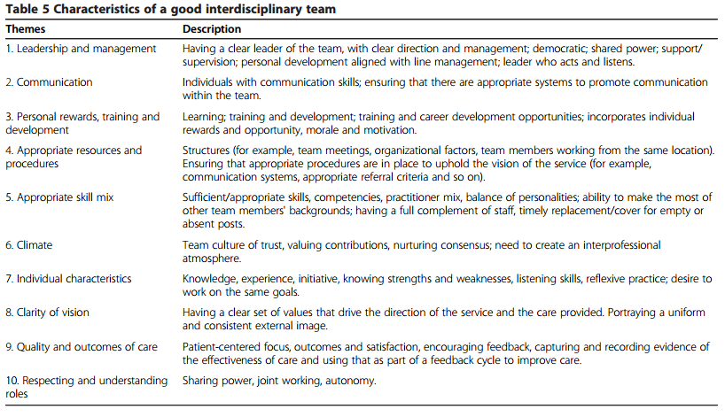

Slide 62
Challenges to interdisciplinary team work
Clarity of vision (the extent to which values are shared by team members)
Communication with external services
Working practices and procedures
Joint-working (observation of peers)
Management/leadership (respecting individual’s autonomy)
Role mix, professional roles and responsabilities

Slide 63
Main limitations (1)
Cost
Time consuming

Slide 64
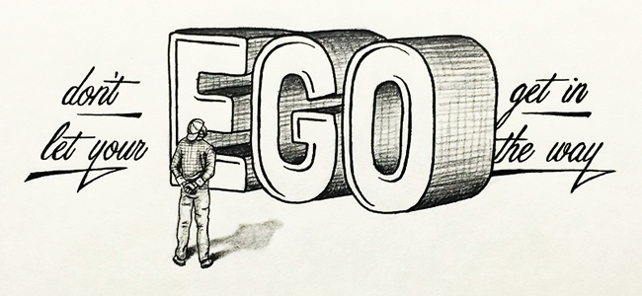
Main limitations (2)
Image Source: Don’t Let Your Ego Get In The Way by Scotty Russell.

Slide 65
Practical steps to build an interdisciplinary network
Identify the « case manager »
Identify who has the leadership
Identify all professionals involved in the patient healthcare (including social worker, school teacher etc…)
Connect the network through a meeting to start and define roles
Collect emails and mobile phones of each participant to communicate in the future

