Slide 1
Exploratory/risk behavior and resilience
1

Slide 2
Today‘s Youth
„"The children now love luxury; they have bad manners, contempt forauthority; they show disrespect for elders and love chatter in placeof exercise. Children are now tyrants, not the servants of theirhouseholds. They no longer rise when elders enter the room. They contradict their parents, chatter before company, gobble up daintiesat the table, cross their legs, and tyrannize their teachers.".“
To whom are these sentences attributed?

Slide 3
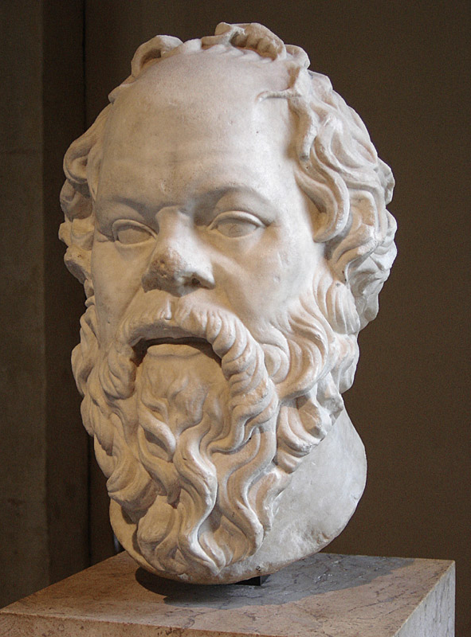
Socrates,
Greek philosopher
469-399 before Christ

Slide 4
Film Adrenalin https://www.youtube.com/watch?v=MH2jAWEDVhM
Do these adolescents feel vulnerable
Do they have any fears?
What drives them?

Slide 5
Buzz Group
Remember you being adolescent
- How did you experiment behaviourally?
-Do you see retrospectively a connection with your developmental tasks?

Slide 6
Objectives
Understand the concepts of exploratory/risk behaviour and resilience in the context of adolescent development
Apply your knowledge to the clinical consultation with the adolescent patient

Slide 7
Clarify (Buzz group)
Risk-taking behavior
Exploratory behavior
perception of risk: same for adolescent and parents/adults?

Slide 8
Risk-taking behavior = Undertaking a task involving a challenge for achievement or a desirable goal in which there is a lack of certainty or a fear of failure. It may also include the exhibiting of certain behaviors whose outcomes may present a risk to the individual/others. or to those associated with him or her.
Exploratory b.=The tendency to explore or investigate a novel environment.
Perception of risk: different for adolescent and parents/adults

Slide 9
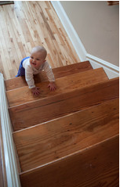
Why exploratory/risk-taking Behaviour?
Analogy:
This toddler is ready to explore his environment,might fall and hurt himself, but will try and try again.

Slide 10
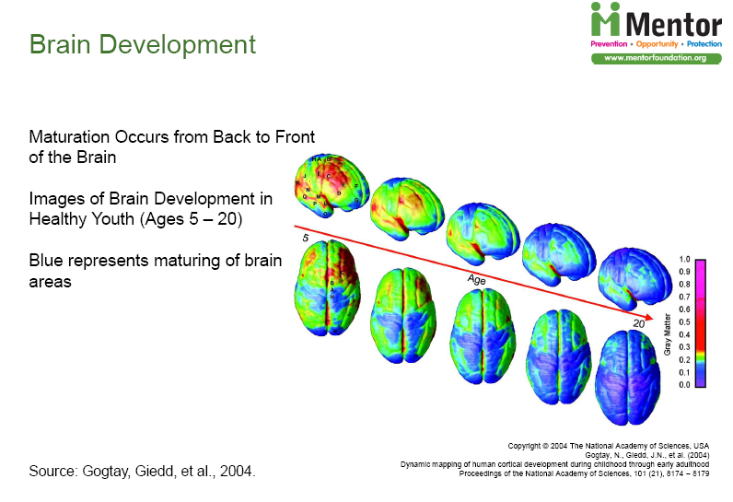
Repetition Neurobiological Basis for Behaviour
The teen brain matures regarding
Prefrontal cortex maturing
Impulsivity: maturing of inhibitory circuits
Motivation:
activation of reward system
activation of control system

Slide 11
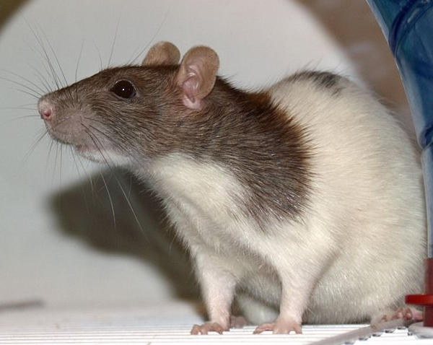
Novelty seeking: other species, too
Rat experiments:
Adult and adolescent rats exposed to open space new environment/objects:
Adolescent rats move further and faster into the new environment, explore more intensly and stay longer with the new objects
e.g. Philpot R et al, Behav. Neuroscience 2008

Slide 12
Consequences of neuroresearch
It is biological normal that teens explore and are not adequately perceiving risks

Slide 13
Functionality of exploratory behavior
Explore adult behavior
Explore identity options
Acquire skills necessary for independence
Explore values
➔ Accomplish developmental tasks
Risk and Opportunity!

Slide 14
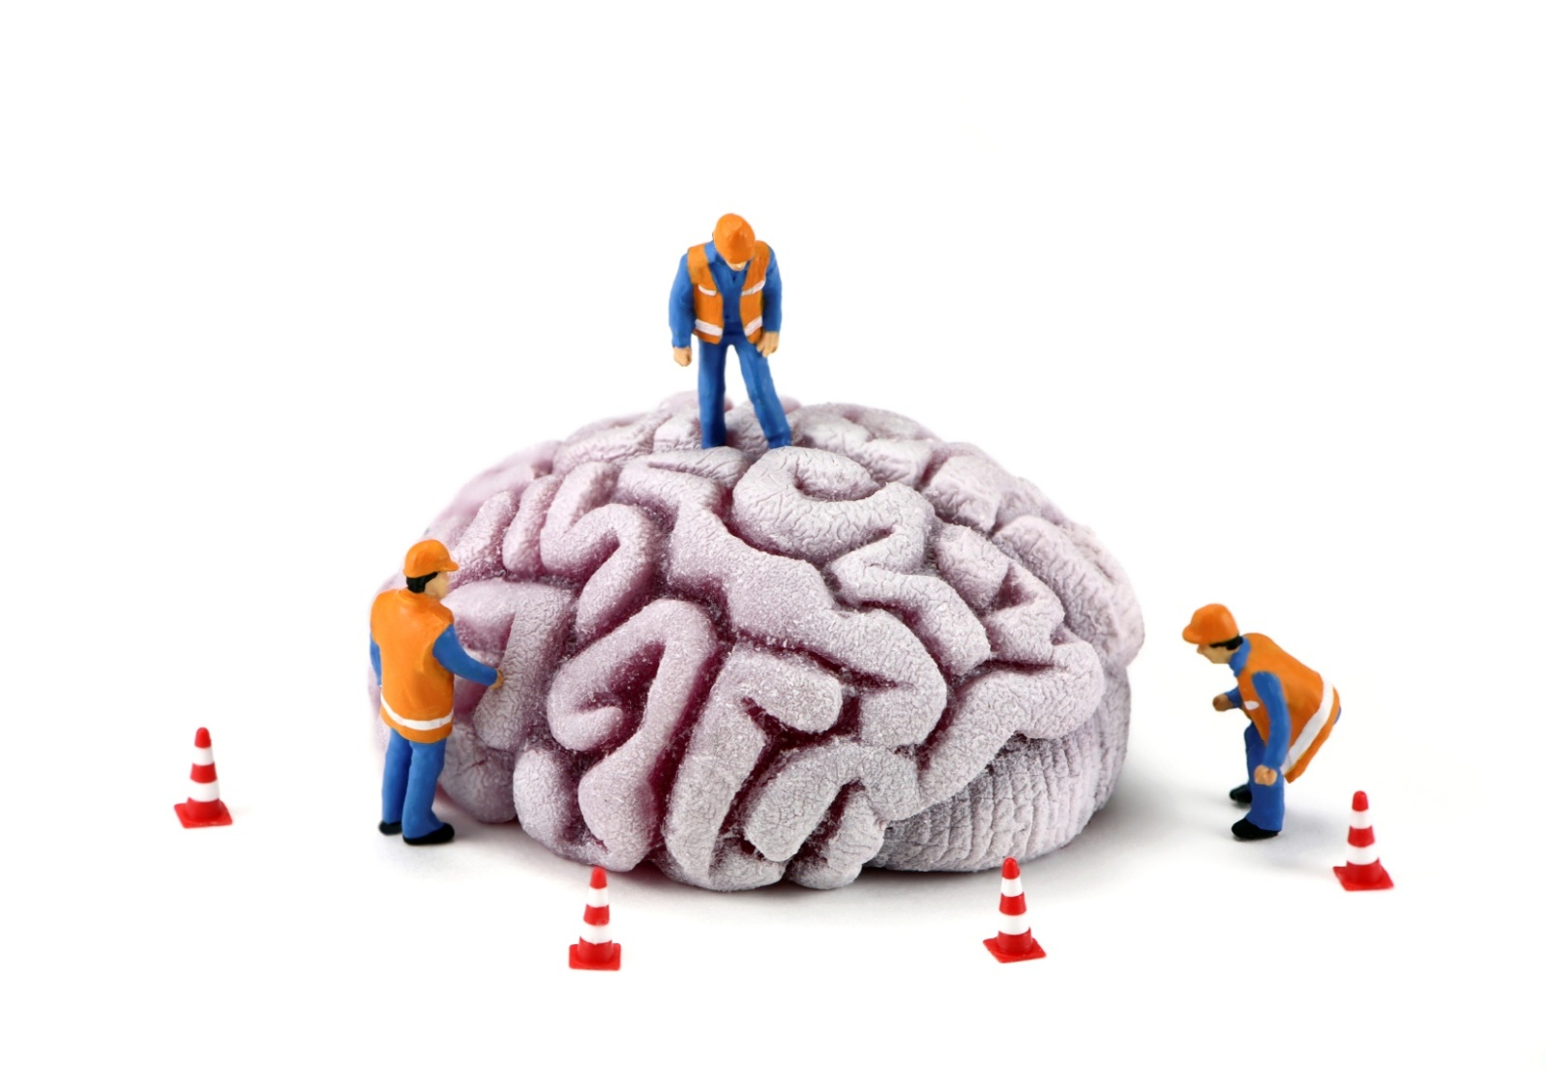
Developmental tasks of Adolescence
Identity
Autonomy
Body Image
Social Role
Sexuality
Values
From Erikson, 1950, 1980, Havinghurst, 1953, etc.
Notes:
Für die Praxis nützliches Konzept, das sich an den Zielen der Adoleszententwicklung orientiert:
Was wird von einem Erwachsenem in der Gesellschaft erwartet?

Slide 15
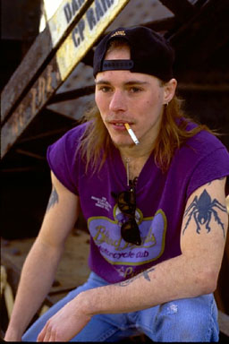
The consultation with the adolescent patient
Determine systematically the risk situation
Is the adolescent presenting « normal » exploratory behavior or is his health seriously in danger?

Slide 16
Das HEADSSS-Screening Interview (Getting into adolescent heads)
Home
Education
Activities
Drugs
Sexuality/Safety/
from Goldenring 1999/2004
Notes:
Colleagues at the Children’s Hospital of Los Angeles have developped this approach with the acronym Heads, to get psychosocial information in a developmentally approriate way.
In this approach the health care provider moves smoothly from less personal question to more personal, intimate questions that are potentially threatening to the adolescent.

Slide 17
Resilience and protective factors clinical work with the Resilience Model

Slide 18



Resilience
Notion from Physics: the power or ability to return to the original form, position, etc., after being bent
Tumbler toy versus porcellan doll

Slide 19
Background:
Salutogenesis
Pathogenese
Pathogenesis
Salutogenesis
Why people get ill?
What is keeping people healthy?
Model:
Health = Normal
Disease = deviation from norm
Model: Continuum
Health/Ease <=====>DisEase
Preventive Intervention
avoid health risks
Preventive Intervention
Enforce the potential of coping
Notes:
Pathogenese: verstehen der Krankheitsprozesse Ursache, Entstehung der Krankheit
Aaron Antonowski
Position auf Kontinuum abhängig von objektivem Befund und subjektivem Befinden

Slide 20
Resilience
The ability to adapt and function despite adverse circumstances.

Slide 21
Resilience
How can youth develop to healthy adults despite
Poverty
Misuse of drugs
violence
Chronic disease
war, Trauma?

Slide 22
Protective factors
Individual faktors
Constitution
Competencies
Environmental factors
family
Sociale Context
Resources
Notes:
16
16

Slide 23
Individual Protective factors
Genetic predisposition
Flexible, aktive strategies of adaptation
Positive perception of oneself
Positive attitude towards life (incl. Spirituality)
Perceived self-efficacy
Internal locus of control
Social competencies
Intelligence
Optimism about the future

Slide 24
Social environmental factors: Family
Positive relation with parents and siblings
Positive family climate
Opportunities to take responsibility within the family (e.g. contributing to household chores)
Clear rules
Social contacts of the family
Notes:
Auch autoritative Erziehung

Slide 25
Social support
A stable relationship with at least one trusting adult
Positive adult role models
Good relations with peers, involvement in prosocial groups
Quality of the school climate
Verfügbarkeit von gesundheitlichen Ressourcen

Slide 26
Your examples of resilience?

Slide 27
Clinical work with the resilience concept
Evaluate risk and resilience/resources (Individual, family, social)
Resources
Risks

Slide 28
Examples of questions exploring resources
What can you do really well?
Tell me about a difficult situation that you mastered well. What made you succed?
What are your future plans?
Where in your life (home, school, peers….) do you take responsibility
What do you like about yourself, what do others like about you?
Do you have a person to adress, when you have problems? Who?
Nach Michaud P

Slide 29
What should we do?
  parents
  School
  Medical doctor

Slide 30
parents
Positive family climate and communication
Positive attitude towards your adolescent
Listen to him/her! Spend time together
Give developmental appropriate independency
Clear rules!…
…

Slide 31
School
School climate
Clear rules including d:
  Ban of tobacco
Availability of professional support: psy-services, drug counseling, ...

Slide 32
Role of the medical doctor
„monitor“ bio-social development
Identify problems with a psychosocial history
Initiate interventions if necessary
Collaborate for prevention with families, school, and communities
Within your medical setting
Referale.g. psychiatry , counseling
Nach Horn W
Notes:
Z.B. Durch bereits Prävention bei den Eltern, schon bei Kleinkindern Exposition an Rauch etc. diskutieren. Eltern auf die Probleme vorbereiten.
Rollenmodell
Aber auch auf übergeordneter Ebene stellung beziehen.:
z.b die Erreichbarkeit von Drogen wird politisch geregelt hat grossen Einfluss auf den Konsum. Lobbying!!!

Slide 33
Role of MD in Public health
Advocay: know you have a say as doctor
Advocate for environments that allow „safe“exploratory behavior for youth.
Counsel schools and the public
Empower parents!

Slide 34


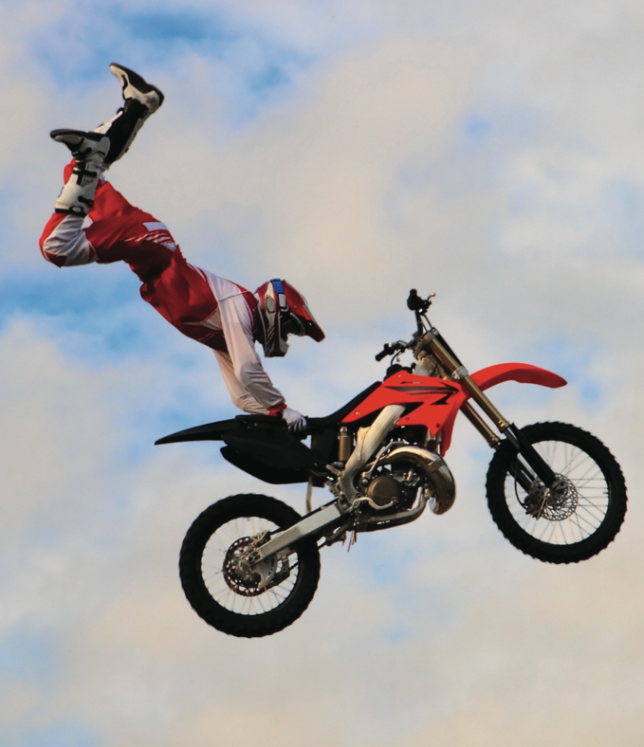
Thank you for your attention

