Slide 1
Young people living with chronic conditions
Module B5
Updated 2017

Slide 2
At the end of this session the participants will ….
Recognize the interrelated impacts of chronic conditions and adolescent bio-psychosocial development
Demonstrate an understanding of the adolescent’s experiencing of chronic condition
Demonstrate proficiency in developing and implementing a management plan including transitional care

Slide 3
Nanna, 14 years
Type 1 diabetes 8 years old
Started treatment with pen and now on insulin pump
Satisfying metabolic control until age 10. Since then increasing HbA1c
Parents divorced 5 years ago
Nanna is in grade 7.
Stays 9 days at her mothers place and 5 days with her father

Slide 4
What has happened in Nanna´s life?
 | Early adolescence | Mid adolescence | Late adolescence
Biological
Cognitive and emotional
Social

Slide 5
Living with diabetes
Burden of diabetes
Diabetes affecting perceived normalcy
Changes in how family and friends treat you
Commissariat PV et al 2016

Slide 6
Living with diabetes
…”so I feel like diabetes is partnered with a big guilt trip, and it’s life-long, and it sucks, hard.” (19-year-old female)
… “but I want to be treated like all the other kids, not just like I have diabetes.” (16-year-old male)
Burden of diabetes
Diabetes affecting perceived normalcy
Changes in how family and friends treat you
I just want to
be a normal kid. But I can’t.” (16-year-old female)
“Living with diabetes is basically like living a normal life,
just with a little bit of extra work.
If everyone else can accept the fact that I have diabetes, I’m great at taking care of my diabetes. If
everyone can’t really do that, then I’m going to pretend that I don’t have diabetes. (19-year-old female)
“I swear it’s like I have 3 or 4 mothers, and they are all like, 'Did you test yourself, you can’t eat that, that’s too much sugar.' I’m like, 'Oh my goodness. I left home to hang out with you guys to get away from my mom and you’re acting like her.' So, yeah they’re extremely protective. I can’t eat candy in their presence, it’s ridiculous.” (18-year-old female)
Commissariat PV et al 2016

Slide 7
Challenges living with arthritis
Health related:
Taking medication
Finding the right medication
Hospital visits
Transfer to adult care
Family planning
Relations:
Telling others
Lack of understanding
Feeling isolated
Intimacy
Individual challenges:
Feeling different
Missing out
Education:
Physical activities
Fatigue
Physical impact:
Pain
Fatigue
Physical activities
Sexuality
Secor-Turner M et al 2011

Slide 8


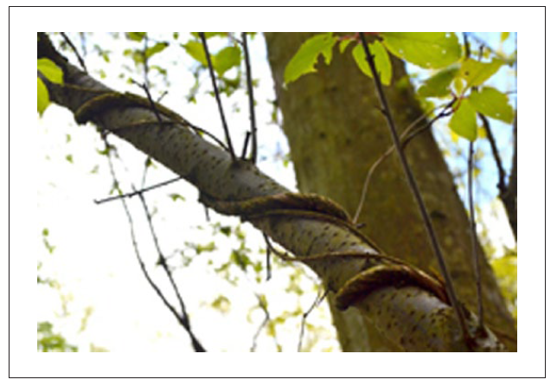
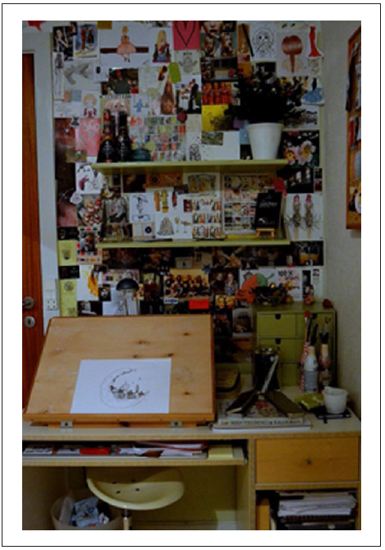

Living with arthritis
out
normal
marginal
home
Hanghøj S et al 2016

Slide 9
Chronic conditions and psychiatric comorbidities – the case of diabetes
The risk of psychiatric disease was trippled 6 months after T1DM diagnosis
(HR 3.00 (95% CI 2.7-3.4))
Later: double risk of psychiatric disease
(HR 2.1 (2.0-2.2)) compared to background population (n=17.122)
Anxiety, depression and eating disorders
Butwicka, Frisen, Almqvist, Zethelius, & Lichtenstein, 2016)

Slide 10
YP, chronic illness and self-harm
Condition | n | Hazard ratio (95% Cl)
Epilepsy | 1886 | 1.9 (1.8 – 2.0)
Asthma | 9144 | 1.7 (1.6 – 1.7)
Migraine | 712 | 1.5 (1.4 – 1.7)
Psoriasis | 169 | 1.6 (1.3 – 1.8)
Diabetes | 1439 | 1.6 (1.7 – 1.9)
Singhal et al., 2014

Slide 11
Risk of self-harm and suicide
Risik of | Somatic illness | Somatic + psychiatric illness
Self-harm | OR 1.21 [99% CI: 1.12 – 1.30] | OR 2.54 [99% CI: 2.28 – 2.82]
Suicidal thoughts | OR 1.22 [99% CI: 1.14 – 1.31] | OR 2.54 [99% CI: 2.27 – 2.84]
Suicidal attempt | OR 1.24 [99% CI: 1.09 – 1.40] | OR 3.48 [99% CI: 3.07 – 3.94
52 % af adolescents with a combination of somatic and psychiatric illness had been self-harming (n = 4099).
Barnes, Eisenberg, & Resnick, 2010

Slide 12
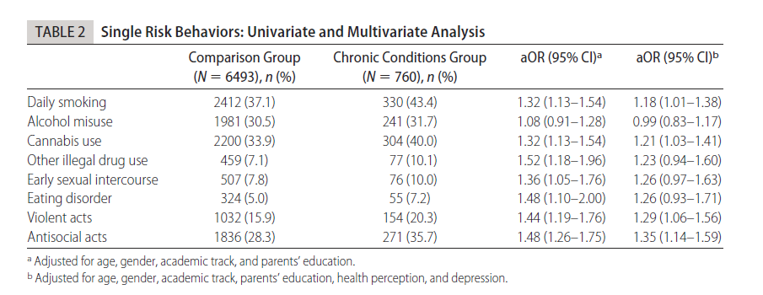
Young people experiment
Suris et al. 2008

Slide 13
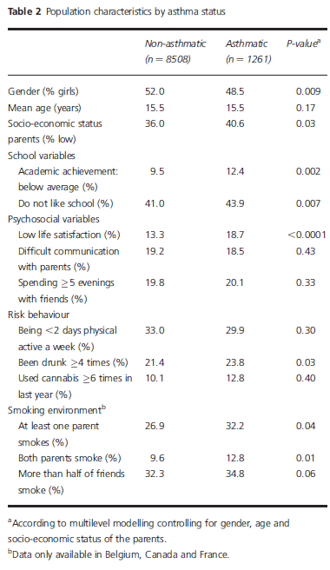
Young people with asthma
Daily smoking prevalence in non-asthmatics is 17.9%
when compared with 20.5% in asthmatic adolescents
Hublet A et al. 2007

Slide 14
Chronic illness and health risk behaviour
Young people with chronic conditions more likely to report ≥ 3 health risk behaviours
Substance use associated with non-adherence
No substance use predictor of successful transfer
Suris JC 2008, Lurie 2000, Stilley 2006, Reid G 2004

Slide 15

Adherence

Slide 16
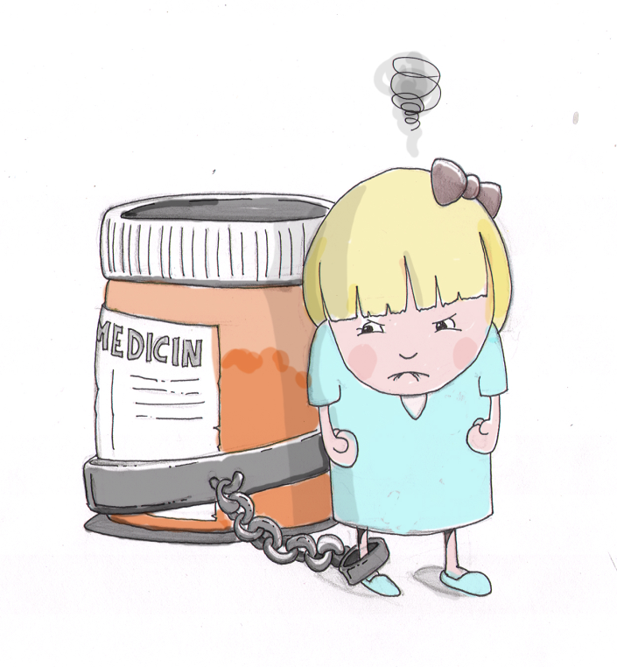
To adhere or not to adhere
– that is the question
Stand up if you have ever used medication for a period
Close your eyes – think back on last time
Keep standing if you adhered 100%

Slide 17
Adherence in numbers
Rules of six:
1/6 come close to perfect adherence to a regimen
1/6 take nearly all doses, but with some timing irregularity
1/6 miss an occasional single day’s dose and have some timing inconsistency
1/6 take drug holidays three to four times a year, with occasional omissions of doses
1/6 have a drug holiday monthly or more often, with frequent omissions of doses;
1/6 take few or no doses while giving the impression of good adherence
Diabetes: adolescents have the lowest adherence
Osterberg L 2005
Cramer JA 2004

Slide 18
CF, lung function and adolescence
CF foundation registry: annual report 2012

Slide 19
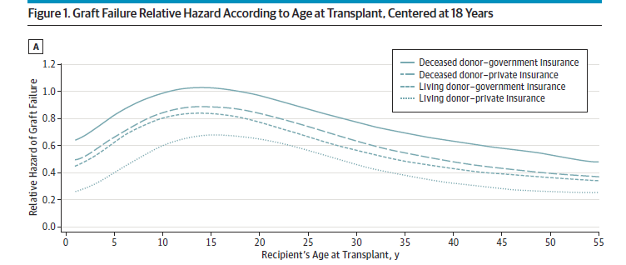
Kidney transplant, graft failure and adolescence
Andreoni KA et al. JAMA Intern Med 2013; 173: 1524-32

Slide 20
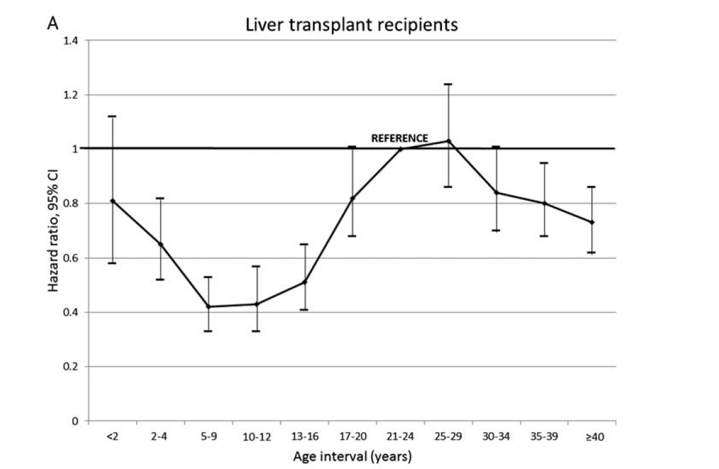
Liver transplant, graft failure and adolescence
Foster BJ et al. Transplantation 2016; 100: 577-84

Slide 21
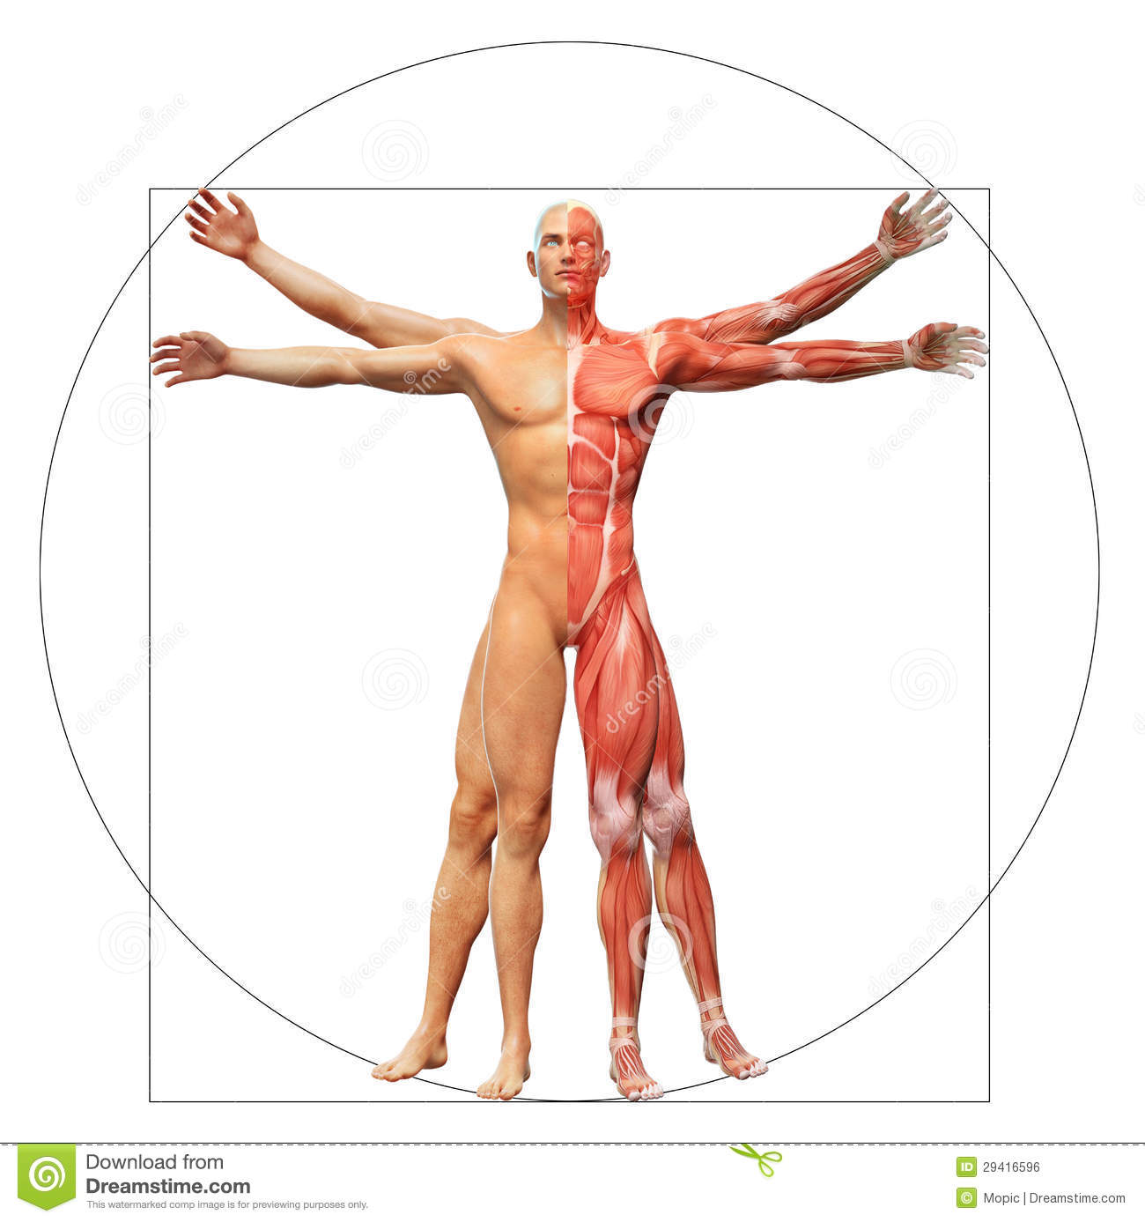
Patient related factors
Social and economic
factors
Disease related
factors
Health care related
factors
Treatment related
factors
Strive for normality
Relations to peers
Relations to parents
WHO 2003
Hanghøj & Boisen 2014

Slide 22
Coffee break ☺

Slide 23
Nanna, 16 years, November
Admitted with ketoacidosis September
Weight loss 8 kg
HbA1c (85 mmol/mol)
1st year of high school with massive absentism

Slide 24
Nanna, 16 years, November
Negotiate a treatment plan with Nanna and her parents
Nanna
Nanna´s father
Nanna´s mother
Health care provider

Slide 25
”It´s time for the transition. I wish I was a magician”
Nobel laureate Bob Dylan 1978

Slide 26
Transition and transfer
Child at pediatric department
with mom and dad
Adult at
adult department?
Voksen?
på voksenafdeling
Child
Adolescent
Young adult
Ung
på voksen-
afdeling

Slide 27
Transition and transfer
Child at pediatric department
with mom and dad
Adult at
adult department?
Voksen?
på voksenafdeling
Transfer
Child
Adolescent
Transitional care
Young adult
Ung
på voksen-
afdeling

Slide 28
Transition and transfer
Child at pediatric department
with mom and dad
Adult at
adult department?
Voksen?
på voksenafdeling
Transfer
Child
Adolescent and young adult
Transitional care

Slide 29
Elements of transition
Principles of adolescent medicine
Self-management of chronic illness
T
Health care systems & training structures
Kennedy & Sawyer 2008

Slide 30
Elements of transition
Principles of adolescent medicine
Self-management of chronic illness
T
Training for HCP
Health care systems & training structures
Info material and ressources
Transition coordinators
Longer appointments
Kennedy & Sawyer 2008

Slide 31
Elements of transition
Promoting autonomy
Parents
Principles of adolescent medicine
Self-management of chronic illness
Risk and resilience
T
Confidentiality
Psychosocial screening
Health care systems & training structures
Kennedy & Sawyer 2008

Slide 32
Elements of transition
Understanding health condition
Principles of adolescent medicine
Self-management of chronic illness
Adherence
Management
of illness
T
Growing capacity for self-care
Health care systems & training structures
Kennedy & Sawyer 2008

Slide 33
What do adult HCP (gastroenterologists) want?
USA (Halt E. 2008)
Holland (Barendse S. 2011)
Patient understanding of disease and its basic nature
Medical summary
Knowledge of medication
Knowledge of impact of substance use in health
Knowledge of own medical history
Medical summary
Knowledge of impact of substance use in health
Patient understanding of disease and its basic nature
Initiate contact if a problem arises between clinics
Impact of disease in life including schooland sexuality

Slide 34
Key elements – a Delphi study
Assuring good coordination between pediatrics and adult care
Starting planning at an early age
Discussing self-management with patient and parents
Including YP views and preferences
Seeing YP alone for part of the consultation if dev. appropriate
Identifying and adult provider
Tailoring the plan to the needs of the patient and family
Identitying a transition coordinator
Provide written health summary and bio-psycho-social profile
Available written transition protocol
At least one fixed appointment in adult care planned
Sufficient knowledge and skills in adolescent health (adult + ped)
Include parents in planning
Suris JC et al 2015

Slide 35
Key elements acc. to EAP
A structured, written policy on how to organize the transition, involving both child and adult health care providers
Involvement of the patient and his family, preparation and planning
Adequate training of staff, sensitization of the adult specialists and teams to the specific needs of the adolescent patient
Continuity of care cooperation and follow up
Financing
Mazur A et al 2017

Slide 36
Different models of transitional care
Patient education and preparation incl. CBT and skills-based interventions
Transition coordinator
Transition-/youth clinics
Mazur A et al 2017

Slide 37
The evidence of transitional care? Cochrane review 2016
RCT-studies, controlled studies, longitudinal studies
All interventions
All chronic conditions
21000 hits -> 4 studies
A total of 238 patients
4 different models
Campbell et al. 2016
Notes:
he participant population (N = 238) in all four trials were adolescents, with the mean age ranging from 16 to 18 years. The transition programmes that were evaluated differed in the types of chronic condition upon which they focused. Huang 2014 recruited patients with a range of chronic conditions that included cystic fibrosis, inflammatory bowel disease, and type 1 diabetes (T1DM). The other trials focused on patients with specific chronic conditions including; heart disease (Mackie 2014), T1DM (Steinbeck 2014), and spina bifida (Betz 2010). All four trials excluded patients who had developmental delay or cognitive impairment. These were small trials, including between 26 and 81 participants each.

Slide 38
patients | intervention | outcome | result
Chronic illness (cystic fibrosis, inflammatory bowel disease, type 1 diabetes), n=81 Huang 2014 | Web- and SMS -delivered skill based intervention | Disease activity Readiness for transition Disease knowledge Well-being and quality of life | Unchanged disease activity Higher self-efficacy og confidence in ability to manage disease
Heart disease, n=66 Mackie 2014 | One-on-one meeting with experienced cardiology nurse | Readiness for transition Disease knowledge | Improwed disease knowledge
Type 1 Diabetes, n=26 Steinbeck 2014 | 3 standardised telephone communications (over six months) from a transition co-ordinator and paper and electronic copies of information | HbA1c | Increased HbA1c in the intervention group
Spina bifida, n=80 Betz 2010 | Cognitive behavioural therapy, 2 day workshop (adolescents and families) | Readiness for transition Well-being and quality of life | No change
Campbell et al. 2016

Slide 39
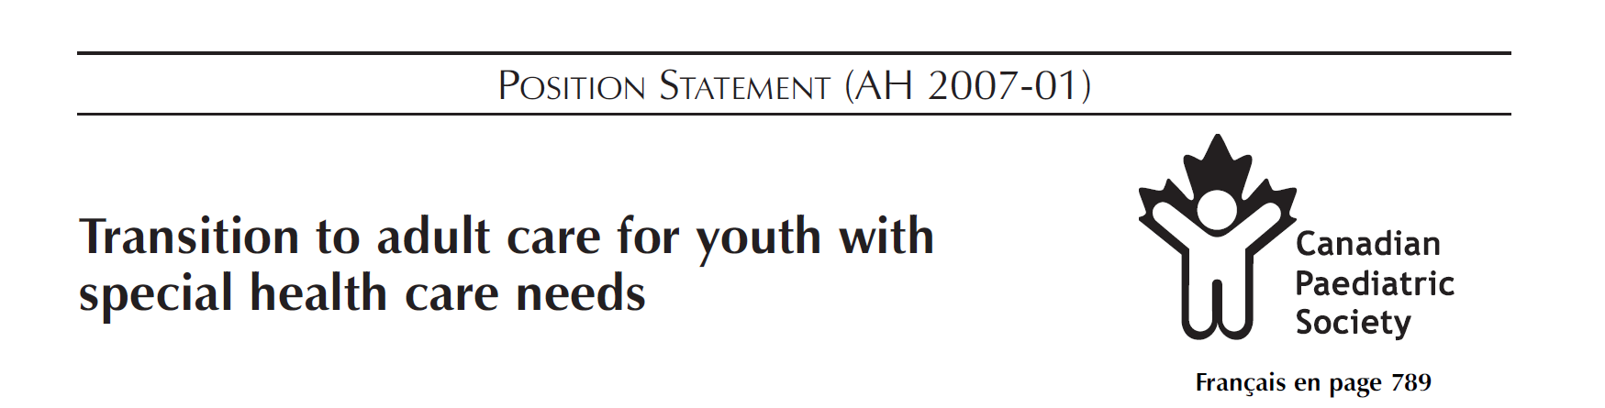

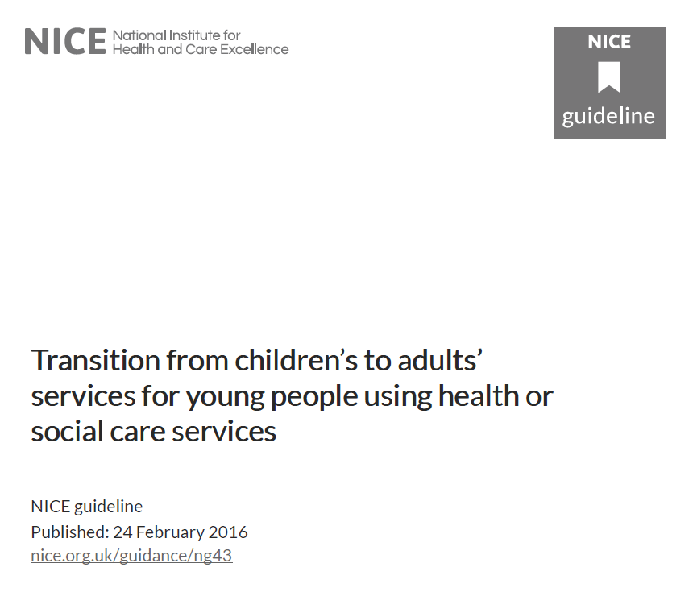
How to…..

Slide 40
Teaching tools
Group work
Mini-lecture
VIPP cards
Standing exercise
Speed dating
Role play
Fish bowl

Slide 41
So far we have learned …...
how chronic conditions may impact bio-psychosocial development in adolescence
how young people experience living with a chronic condition
how to address, assess and improve adherence
how to develop and negotiate a treatment plan
how to develop and implement a transition program

