Slide 1
Injuries and violence prevention
November 2017

Slide 2
objectives
Identify the variety and range of injuries, violence, bullying and abuse occurring to and by young people, and identify factors associated with the occurrence of these events
Recognize the signs and symptoms of major injuries, violence, bullying and abuse occurring in young people, skillfully approach individual cases, and bring them into the care system
Advocate for, and practice, early detection, intervention, and prevention of the major forms of injury and violence by and to adolescents

Slide 3
Discuss the situation of various forms of violence in your country
Intentional self injury:
Suicide/Attempted suicide
Deliberate self harm such as cutting
Unintentional self injury
Self induced accidents
Sports injuries and tests of courage
Experimentation with harmful substances
Violence (Intentional injury by others)
Homicide
Bullying, assault
Physical and sexual abuse
Ritual female circumcision
War/armed conflict
Unintentional injury by others
Road accident
Household/occupational injuries

Slide 4
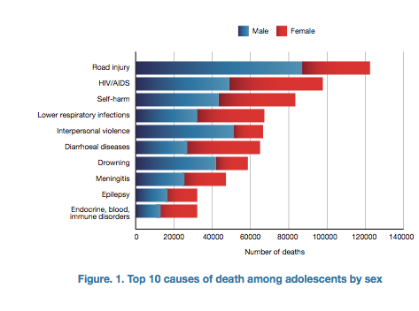
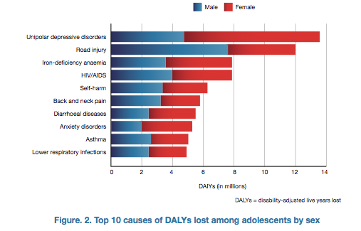
Remind mortality

Slide 5
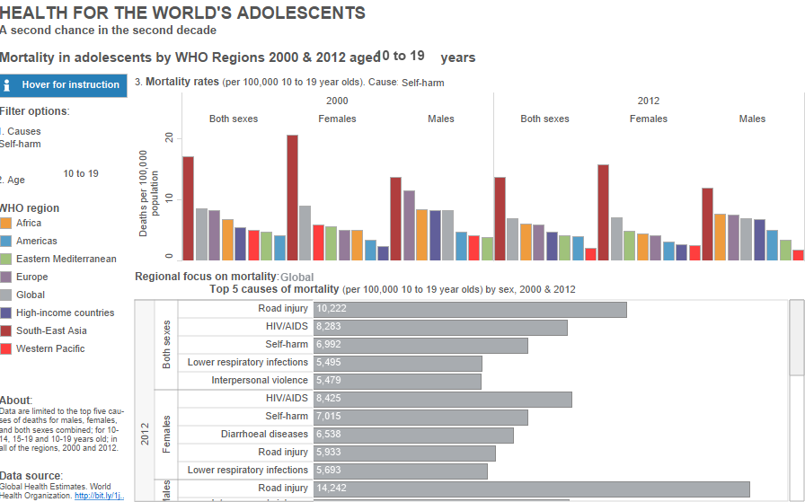
Self-harm

Slide 6
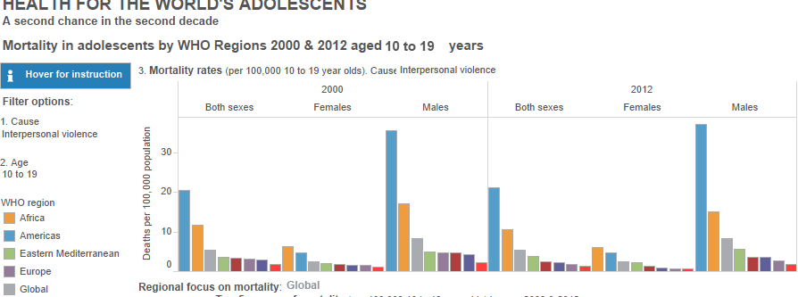
Interpersonal violence

Slide 7
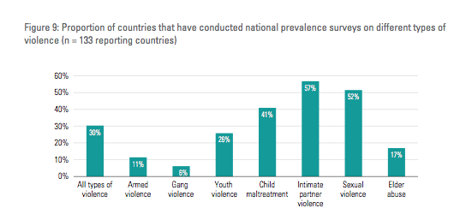
The data proble
Lack of good data
60% of countries do not have usable data on homicide
http://www.who.int/violence_injury_prevention/violence/status_report/2014/en/

Slide 8
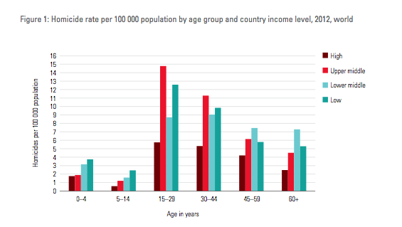
Global status report on violence
2014
Notes:
Highest rate between 15-29,
Problem is upper middle and low class
Higher class little problem

Slide 9
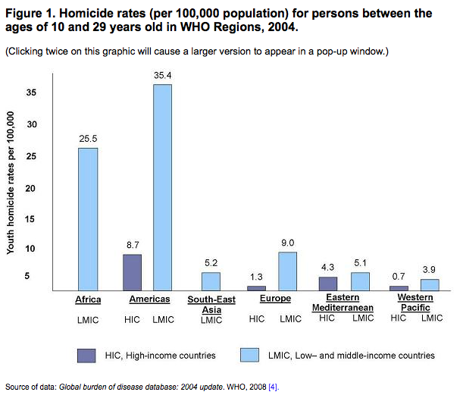
Notes:
EM comparatively low.

Slide 10
Youth violence
Some key facts:
Mostly reported as violence occurring between people aged 10–29 years.
often occurs among youth who are not relatives
generally takes place outside of the home
Consequences range from serious injury or death to more emotional/mental health than physical harm, including risk behaviours, such as smoking, alcohol and drug use, and unsafe sex.
Most of this and following slides based on: www.who.int/violoence_injury_prevention/capacitybuilding/teach_vip/en/

Slide 11
Youth violence (2)
Worldwide an estimated 200000 homicides occur each year among youth aged 10–29 years, accounting for 43% of all homicides annually.
In over 80% of deaths due to youth violence the victim is a male
For each young person killed, many more sustain injuries requiring hospital treatment.
Perpetrators and victims of youth violence often have a long history of involvement in violence, and many were victims of child maltreatment

Slide 12
Youth Violence (3)
Often occurs between young people who know one another, that is, who are friends, classmates , or acquaintances.
is often motivated by interpersonal arguments and rivalries (rather than being purely economic in nature).
significant roles for the availability of drugs, alcohol, and firearms

Slide 13
Peer violence: Victims and perpetrators
Often it cannot been distinguished between „victim“ and „perpetrator“
Half of the victims of youth violence seem also to be perpetrators
are often similar in many important respects such as age, ethnicity, socioeconomic status, and life experience.

Slide 14
Victims and perpetrators:
tend to be young males. Both perpetration and victimization peak at 15–17 years of age. This is very close to the peak age (12–16 years) for adolescent susceptibility to peer pressure and for development of social identity [8]They live in poor urban areas.
They engage in illicit activities that cause interpersonal conflicts (e.g. belonging to a gang, selling drugs and stolen goods).
They associate with delinquent friends who have poor social and problem-solving skills.
They victimize others who are like themselves [9].
They have little recourse to legal means of conflict resolution (e.g. the justice system) [10].

Slide 15
Role of health professionals
Identification of victims / confirm CAN
Understand the circumstances and how the victim feels about it
Take care of consequences (mental/physical)
Collaborate with the police/social services
Sensitize school staff

Slide 16
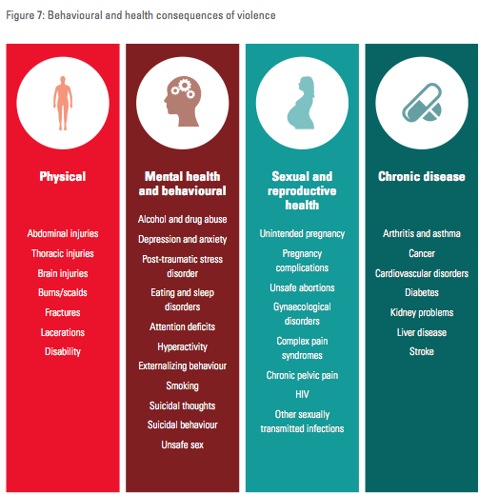

Slide 17
School Bullying
A form of youth violence
Major social problem worldwide affecting wellbeing of children/adolescents
Systematic abuse of power where aggressive behaviour or intentional harm-doing by peers is carried out repeatedly
Characterized by an imbalance of power (acutalr or perceived) between victim and the bully

Slide 18
Forms of bullying | Activities performed
physical bullying | hitting, pushing, kicking
relational bullying | name calling, teasing
social bullying | rumour spreading, intentional social exclusion
damage of property or personal belongings | stealing or damaging possessions
From HBSC.org

Slide 19
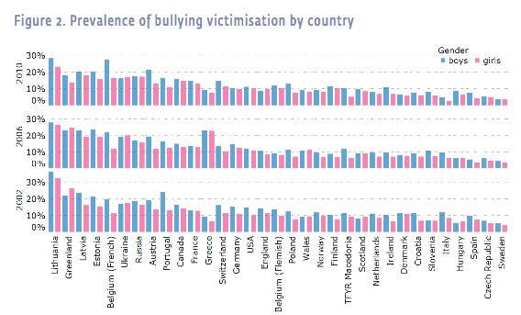
Prevalence of School Bullying HBSC
Male dominance
Decrease over time
Based on response: 2–3 times a month’ and more
2–3 times a month’ and more

Slide 20
Consequences of bullying on victim
Short term:
Anxiety,
low self-esteem
Feeling lonely
Risk from self-harm
Suicidal ideations
Long term*
Chronic victimisation
Higher risk
for psychotic symptoms (agarophobia, panic disorder, generalised anxiety)
Internalising symptoms, depression
Suicidality
Panic disorder
*e.g.Copeland WE, JAMA Psychiatry 2013. Zwierzynska K, J abn child dev 2013
Notes:
9. Copeland, William E et al. “Adult psychiatric outcomes of bullying and being bullied by peers in childhood and adolescence.” JAMA psychiatry 70.4 (2013): 419-426.
10. Zwierzynska, Karolina, Dieter Wolke, and Tanya S Lereya. “Peer victimization in childhood and internalizing problems in adolescence: a prospective longitudinal study.” Journal of abnormal child psychology 41.2 (2013): 309-323.
11. Schreier, Andrea et al. “Prospective study of peer victimization in childhood and psychotic symptoms in a nonclinical population at age 12 years.” Archives of general psychiatry 66.5 (2009): 527-536.

Slide 21
Special form of violence: Sexting
sending and receiving sexually explicit messages, primarily between mobile phones.
2012, the word sexting was listed for the first time in Merriam-Webster's Collegiate Dictionary.
Prevalence about...
Many prevention campaings targeting media competencies of yp

Slide 22
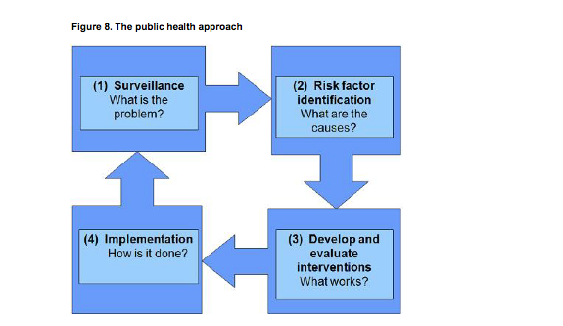
The public health approach for prevention
Notes:
The public health approach to injury and violence prevention is a process that uses four key steps to move from problem to solution [15]. These steps are:
Conduct surveillance and collect data on the magnitude, scope, characteristics, and consequences of injury and/or violence to help define the problem at hand and identify areas in which prevention is needed.
Identify risk factors for a particular injury problem to help us understand the causes and correlates of injuries and violence, the factors that increase or decrease the risk of injury or violence, and the factors that might be modified through interventions.
Develop and evaluate interventions based on the information gathered in the first two steps.
Implement proven interventions, that is, interventions that the evaluation research has shown to be effective.
The public health approach to injury prevention is illustrated in Figure 8.
It is multidisciplinary. The public health approach draws on many disciplines, including medicine, epidemiology, engineering, sociology, psychology, criminology, education, and economics.
It is population based. The public health approach seeks to promote health and safety to groups of people rather than individuals.
It is evidence based. The public health approach relies on data and the scientific method and seeks to use interventions that research and evaluation have shown to be effective.
It emphasizes collective action. The public health approach relies on cooperative efforts from diverse sectors, such as health, education, social services, justice, and policy.
It emphasizes prevention. Public health is characterized by an emphasis on prevention and a belief that injuries – and disease – can be prevented.

Slide 23
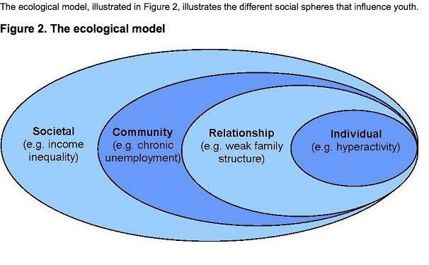
Analysis of riskfactors

Slide 24
Individual risk factors
Related to puberty ➔ „adolescent limited“
Exploratory behaviour (see lecture on exploratory/risk behaviour) including neurological changes, dominance of limbic system, lack of control of impulsivity etc
Role of peer pressure, stress, frustration, search for identity
Alcohol increasing agressiveness and impulsivity
Persistent individual morbidity
Learning disability
Neurological deficits
Psychiatric/psychological disorderss

Slide 25
Family risk factors
Poor parenting and poor monitoring
Weak family structures
Poor family communication
Poor social support
Family violence
...

Slide 26
Community risk factors
Low SES
Unemployment
Urbanity
Weak social control, cohesion and support, isolation
Community violence, availability of weapons, drug trade
Community values: „toughness“, violence..

Slide 27
Prevention approaches
Interventions based on risk factors
Focus on youth: „Life skill programmes
Family suport programes: reduce risk and strenghten protective factors
Community interventions: School programmes, community support and policies

Slide 28
Focus on youth
Lifeskills programms: manage anger, resolve conflict and develop the necessary social skills to solve problems.
Evidence for effectiveness:
Preschool enrichment programmes (E.g. headstart US)
Social Development programmes promoting pro-social behaviour (e.g. PATHS Promoting alternative thinking strategies)

Slide 29
PATHS Programme (initiated in the US 1996)
More than 1400 classes involved in Switzerland (from Kindergarten to secondary school)
Focus combined on behaviour improvement and positive school culture
Rules and ways of behaviour
Healthy self-esteem
Feelings
Self-control
Problem solving skills
Relations among pupils, living together
Strategies of organizing the school
Durlak, JA et al, Child Development. 2011.
Notes:
Durlak, Joseph A. et. al. 2011. The Impact of Enhancing Student’s Social and Emotional Learning: A Meta-Analysis of School-Based Universal Interventions. In: Child Development. Vol. 82. P. 405-432.

Slide 30
Family programmes
Early childhood!: prenatal and postnatal care and homevisitation programmes: foster positive parenting practices

Slide 31
Community interventions
School programmes
SHE: school for health in Europe (see lecture on school health)
Prevention programmes against bullying
PATHS
After school programmes
Community policies regarding availabilty of weapons, exposure to media violence etc.

Slide 32
Preventive interventions on the health care service level
Train HC-staff to
recognize warning signs (associated with risks for youth violence, suicide etc)
learn how to ask questions about violence experience, anger, strategies to handle anger, presence of suicidal thoughts and feelings ➔ HEADSSS
Help adolescent to accept and realize referral.
promising approach: e-learning programms
(e.g. Ghoncheh R, JMIR Mental Health 2016, http://mental.jmir.org/2016/1/e8/)

Slide 33
Prevention of Bullying
Whole school approach across disciplines and with whole school community more effective than curriculum based activities and targeted social learning groups
Prohibit bullying
Promote mutual respect, tolerance, supportive peer relationships,
Promote cooperative learning

Slide 34
Prevention of bullying (2)
Adult supervision at key times
Create a culture, where bullying incidents are reported and an organised response supports victimbs and provides counselling to the perpertrator
Interventionsshould last longer than 6 montghs. Targeting adolescents >11y more efeectivethan targeting younger children
➔ refer to HBSC Bullying factsheet http://www.hbsc.org/publications/factsheets/Bullying-victimisation-english.pdf

Slide 35
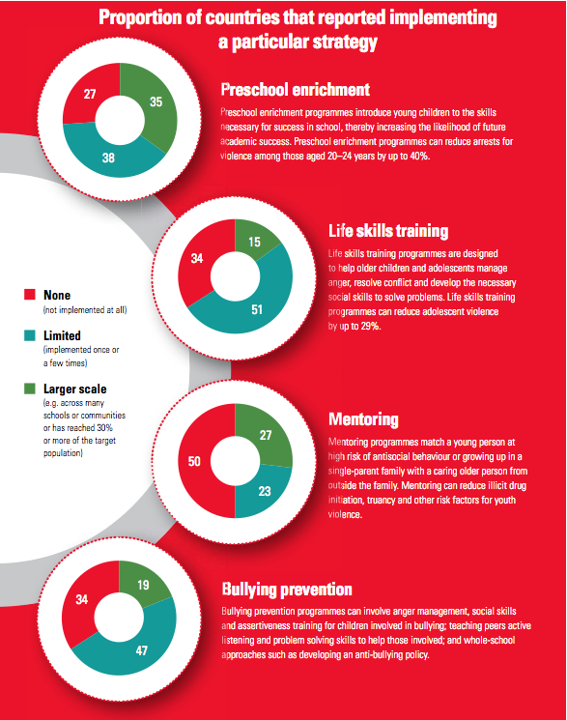

Slide 36
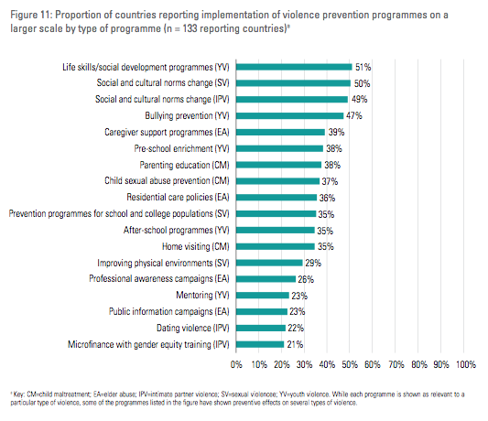

Slide 38
Short comments on road traffic injuries

Slide 39
What factors put teen drivers at risk? (Center for disease control and prevention)
Teens are more likely than older drivers
to underestimate dangerous situations or not be able to recognize hazardous situations.
to speed and allow shorter headways (the distance from the front of one vehicle to the front of the next)
The presence of male teenage passengers increases the likelihood of this risky driving behavior.
Among male drivers between 15 and 20 years of age who were involved in fatal crashes in 2005
37% were speeding at the time of the crash
26% had been drinking.^{8,9}
lowest rate of seat belt use
In 2005, 10% of high school students reported they rarely or never wear seat belts when riding with someone else.¹⁰
Male high school students (12.5%) were more likely than female students (7.8%) to rarely or never wear seat belts.¹⁰

Slide 40
Prevention of road accident injuries of teens
Wearing seat belts
Not drinking and driving
Graduated Driver Licensing Programs (GDL)
longer practice periods,
limits driving under high risk conditions for newly licensed drivers, and
requires greater participation of parents in their teens' learning-to-drive.
http://www.cdc.gov/motorvehiclesafety/teen_drivers/teendrivers_factsheet.html

Slide 41
Parent‘s role or school?
Make sure your young driver is aware of the leading causes of teen crashes:
Driver inexperience
Driving with teen passengers
Nighttime driving
Not using seat belts
Distracted driving
Drowsy driving
Reckless driving

Slide 42
Useful resources
www.teach-vip.edc.org or www.who.int/violoence_injury_prevention/capacitybuilding/teach_vip/en/
Violence prevention: the evidence. Geneva WHO 2009
Global status report on violence prevention: http://www.who.int/violence_injury_prevention/violence/status_report/2014/en/
Resource on Paths: Malti et al 2012: http://ijcv.org/index.php/ijcv/article/viewFile/271/pdf_68

Slide 43
EARLY MARRIAGE

Slide 44
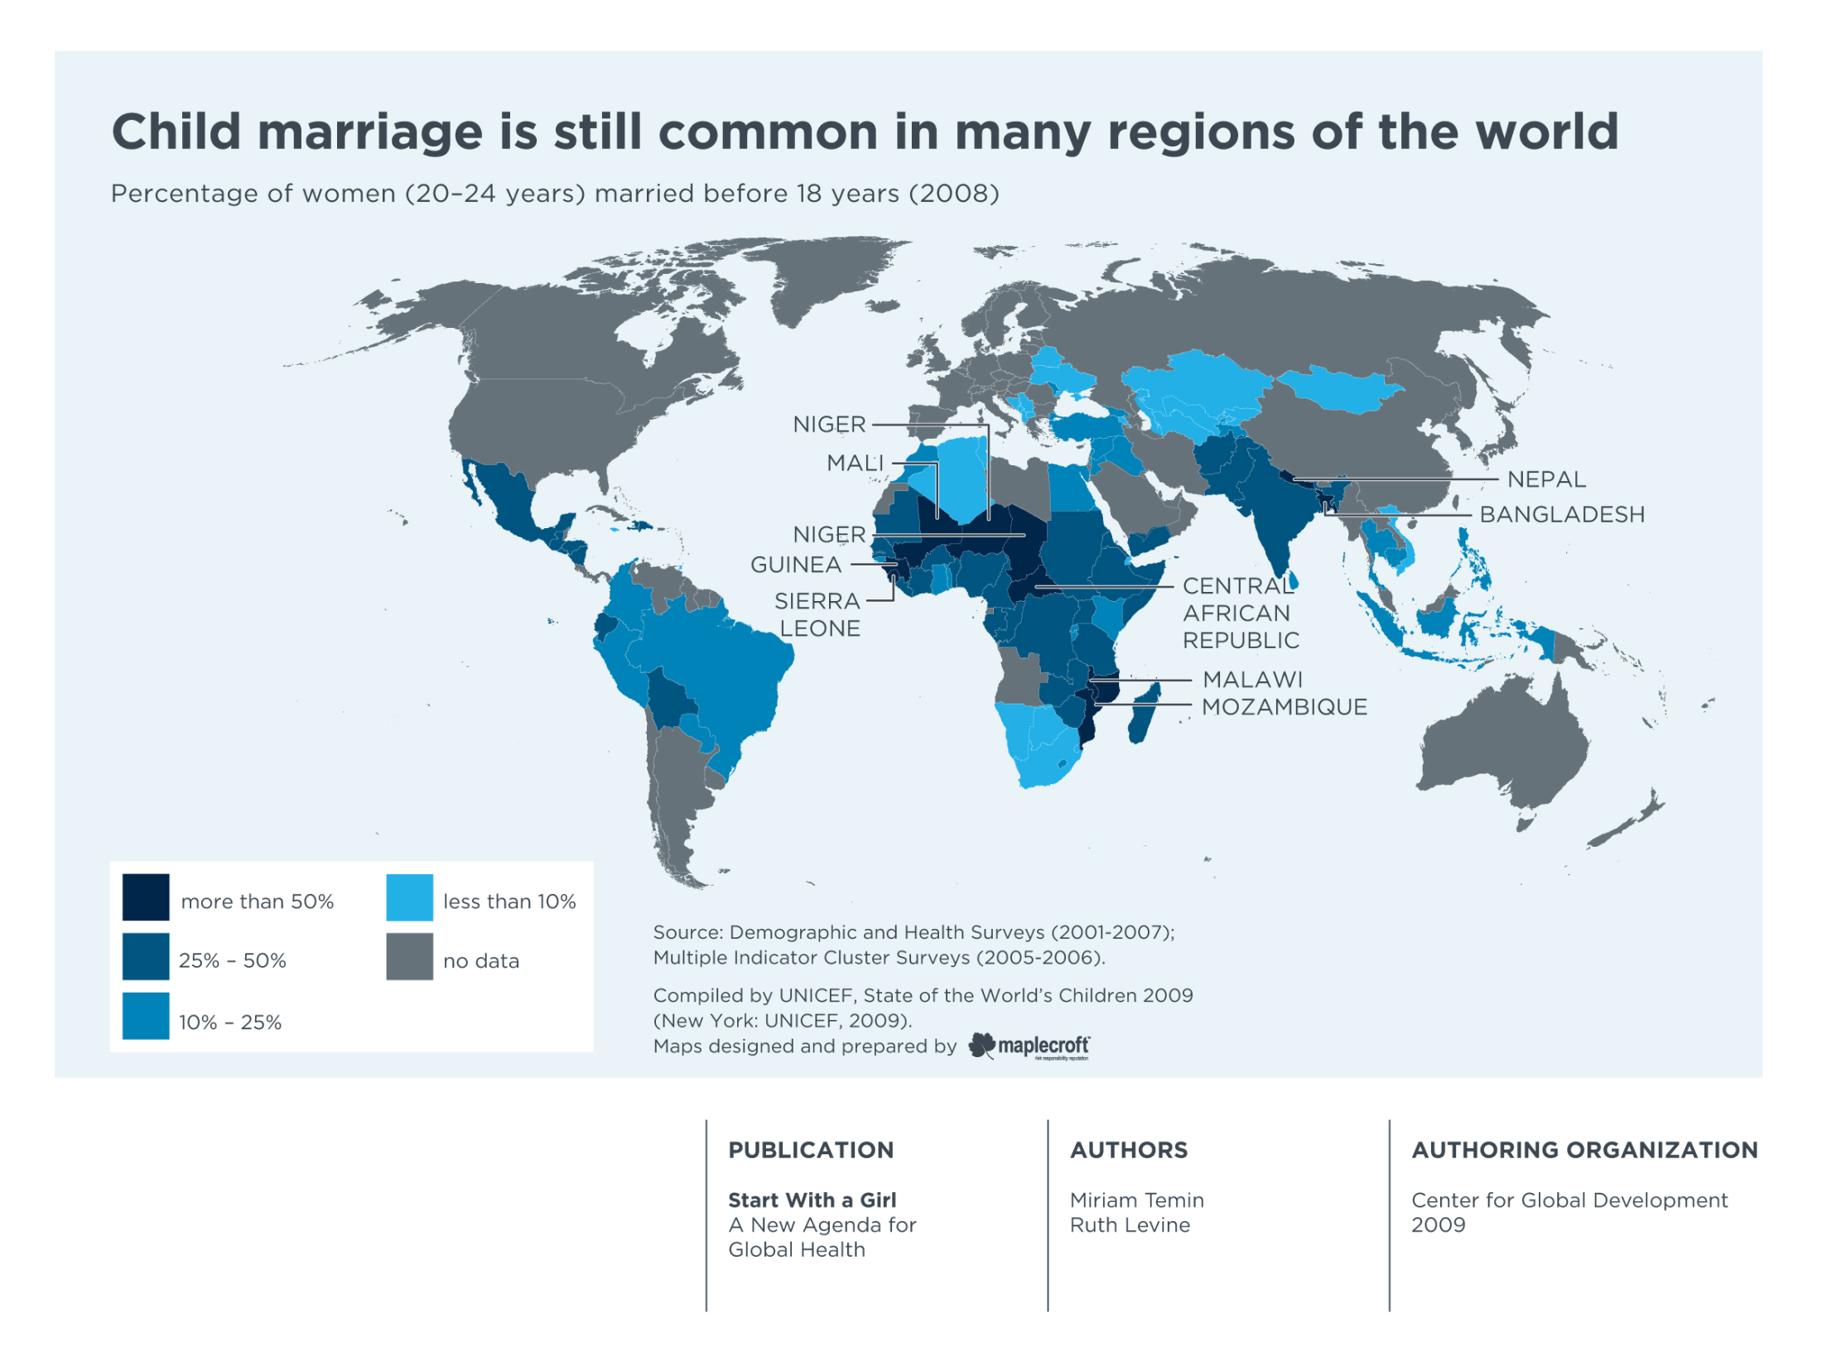
Notes:
Map 2.1 Child marriage is still common in many regions of the world, Page 20 (not data in northern countries….
Despite positive trends toward decreasing rates of child marriage, the practice remains widespread in many parts of the world. Excluding China, 36% of 20–24-year-old women in the developing world marry before age 18. The frequency of child marriage varies regionally, with 49% of 20–24-year-olds married by 18 in South Asia and 44% in West and Central Africa.
Child marriage robs girls of the opportunity for education, skills, and social networks which could help build healthier lives and improve outcomes for themselves and their children. Child marriage is most common where other alternatives for girls, such as schooling and opportunities to improve their livelihoods, are limited.
So let me tell my story…….

Slide 45
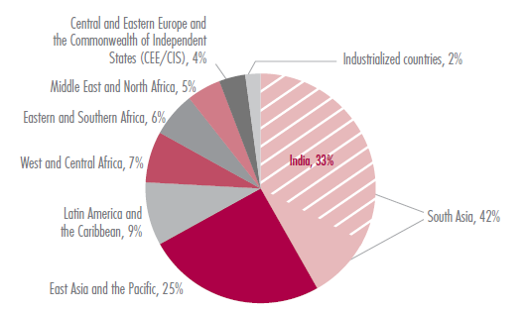
Percentage distribution of women aged 18 years and older who were married or in union before age 18, by region

Slide 46
EARLY MARRIAGE
Early or child marriage is the union, whether official or not, of two persons, at least one of whom is under 18 years of age Article 1108 of the Civil Code of Georgia allows for a marriage of a person at the age of 16 years in exceptional circumstances with the consent of the parents
associated with:
withdrawal from education,
low socio-economic status of families,
early childbirth with the
risk of child’s disability and maternal mortality

Slide 47
EARLY MARRIAGE
Lack of good data…
17% of Georgian women were married before the age of 18 ? Georgia has one of the highest rates of early mariage along with Moldova (19%) and Turkey (14%)
most child marriages are not officially registered
school dropout rate alarming in the Kvemo Kartli region and in Tbilisi; e.g. during the last five years, 341 students dropped out of schools in Marneuli
PSA/UNFPA,2014

Slide 48
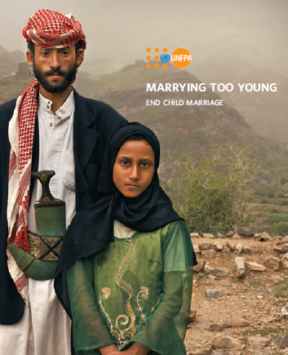
RESPONSES
Policies discouraging early marriage, e.g. cash transfer
Enforcing the respect of the law
Community interventions
School education
Others ?

Slide 49
Sex ratio at birth
Country | Sex ratio at birth
Azerbeidzjan | 1.13
Albania | 1.12
Armenia | 1.12
China | 1.12
India | 1.12
Vietnam | 1.11
Georgia | 1.11
Guilmoto, 2013

